Slide 1






Crop Guard – Animal detection in crop fields
SURESH ANGADI EDUCATION FOUNDATION’S
ANGADI INSTITUTE OF TECHNOLOGY AND MANAGEMENT
Savagaon Road, BELAGAVI – 590009.
(Approved by AICTE, New Delhi & Affiliated to Visvesvaraya Technological University, Belagavi, Accredited by NAAC)
Submitted By- TEJASHWINI RATHOD PRATHAMESH CHOUGULE SHRIRAM HEBBAR SHRINATH KORAJKAR
Project Guide- PROF. DHANASHREE KULKARNI

Slide 2



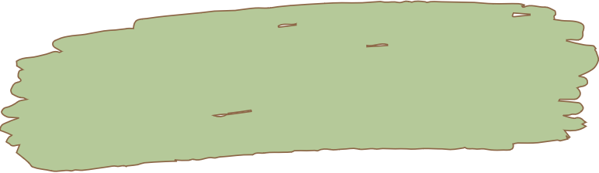



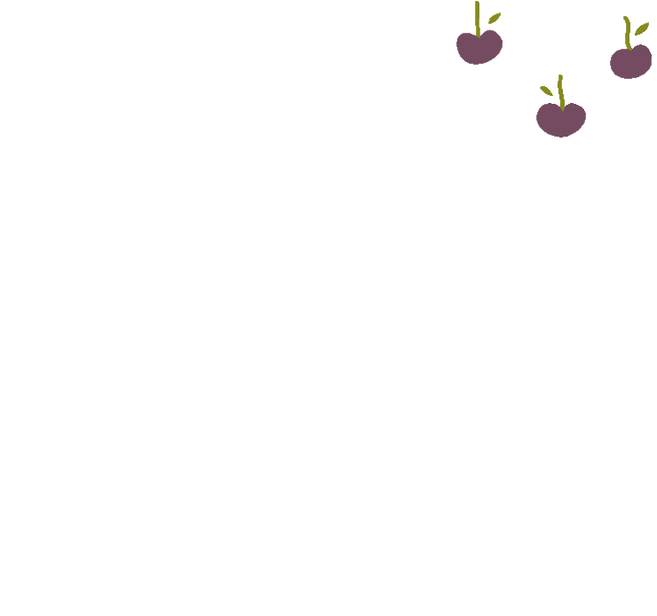

ABSTRACT
Crop damage caused by animals is one of the major threats in reducing the crop yield. Traditional methods followed by farmers are not that affective and it is not feasible. Since safety of both human and animal is equally vital, it is important to protect the crops from damage caused by animals and divert them without any harm. Thus the proposed system monitors entire farm through a camera which will be recording the surroundings and play appropriate sounds when animals are detected to drive them away from field.

Slide 3



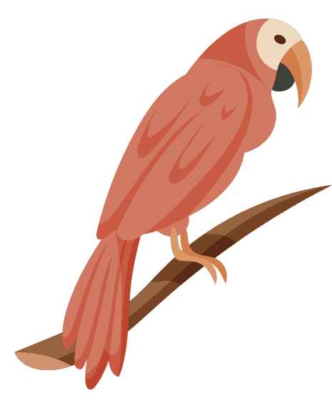

INTRODUCTION
Agriculture is the most important sector of the Indian Economy, one of the major social problems that is existing in the present is the damaging of the crops by the wild animals. It has always been a persistent problem to the farmers. These animals may feed on crops and also run around the field in absence of farmer and thus cause damage to the crops. This may in turn results in significant loss in the yield and will cause additional financial protection. The proposed project aims to address this problem and detect the animals using animal detector and with synthetic images we try to improve the efficiency of the animal detection.

Slide 4

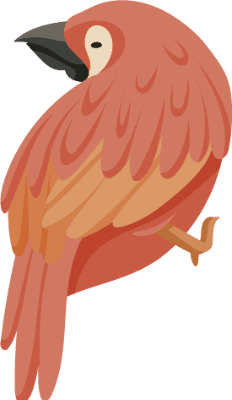
PROBLEM STATEMENT
Animal attacks are typical occurrence in India these days, also they destroy crops due to lack of any detection system. Traditional methods for preventing the trespassing of animals is either by humans which is a common practice or shocked by electric fences where there is a risk of fire. Today we have some of the object detection methods which detect the animals using CNN. These techniques have lower accuracy. The proposed method make use of synthetic images generated by LSGAN which increases the accuracy and make animal detection more efficient.
Disadvantages of the existing system:
Existing manual techniques has a risk of getting injured by both animals as well as humans.
In case of electric fences there is a risk of fire if plants and shrubs grow too close to the fence. If not adequately maintained, electromagnetic interference may occur.
Thorn fencing also doesn't prove to be efficient.

Slide 5

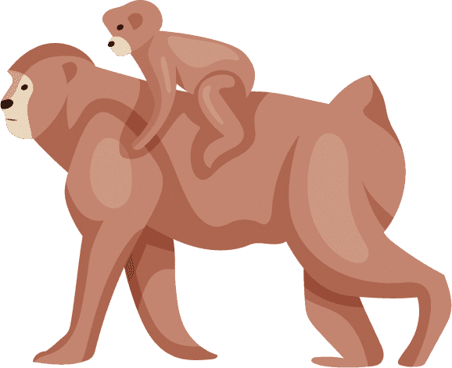


PROPOSED SYSTEM
The proposed solution for identifying or locating the wild animals that trespass the crop fields is using a Deep Learning approach that involves reading data from live-video from a camera installed in the farm.
The images from training dataset are improved for better image quality and then synthetic images of these images are generated which is added with original dataset for better performance.
The live data is then fed to the animal detector for detection of animals and set an alarm to drive them away.
Advantages of proposed system:
Safety of animals and humans:- both humans and animals are saved from harming each other.
Crop yield protection:- The crop yield is protected from the animals due to which farmer gets relived from continuous observation.

Slide 6

OBJECTIVES
To identify or locate the wild animals that trespass the crop fields and destroy the crop yield.
To capture the images of trespassers and improve the quality of images taken to produce synthetic images for them for better performance
Pass the modified dataset with various with various image size to object detector and detect the animal
Analyze the performance of the proposed method with traditional methods

Slide 7


LITRATURE SURVEY
Title: Yolo v4 for Advanced Traffic Sign Recognition With Synthetic Training Data Generated by various GAN.
Author: Christine Dewi, Rung-Ching Chen, Yan-Ting Liu, Xiaoyi Jiang, Kristoko Dwi Hartomo.
Journal: 2021 IEEE 15th International Conference on Industrial and Information Systems (ICIIS).
Year: 2021
The paper describes how the quality of synthetic pictures created by DCGAN, LSGAN, and WGAN is determined.
It combines synthetic images and original images to enhance datasets and verify the effectiveness of synthetic datasets.
After mixing the real images with synthesized images produces by LSGAN, the recognition performance has been improved with 84.9% on YOLO v3 and 89.33% on YOLO v4.

Slide 8


LITRATURE SURVEY
Title: Wild Animal Intrusion Detection using Deep Learning Techniques.
Author: DR. R.S. Sabeenian, N. Deivanai, B. Mythili.
Journal: International Journal of Engineering and Advanced Technology (IJEAT).
Year: 2020
Here machine learning is used to detect animals by using deep neural network concept, a division in computer vision.
The farm is monitored through camera on regular basis and with help of machine learning model, it detects entry of animals and play sound to drive them away.
It works on limited animal dataset with very low accuracy.

Slide 9

LITRATURE SURVEY
Title: Machine Learning-based Acoustic Repellent System for Protecting Crops Against Wild Animal Attacks.
Author: Devsmit Ranparia, Gunjeet Singh, Anmol Rattan, Dr. Harpreet Singh, Dr. Nitin Auluck.
Journal: 15th (IEEE) International Conference on Industrial and Information Systems (ICIIS) 2020
Year: 2020
Here an Acoustic Repellant System has been designed which uses a conventional neural network based ML model and an IR camera to identify target animals.
A Raspberry Pi (Rpi) module has been integrated with a camera and frequency generator to recognize different animals.
The system has a problem of using IR camera which gives positive result for both domestic and non harmful animals.

Slide 10



LITRATURE SURVEY
Title: Design, Development and Evaluation of an Intelligent Animal Repelling System for Crop Protection Based on Embedded Edge-AI.
Author: Davide Adami, Mike O. Ojo, Stefano Giordano.
Journal: International Journal of Recent Technology and Engineering (IJRTE)
Year: 2021
Here edge computing devices like Raspberry Pi and NVIDIA Jetson Nano with YOLO and Tiny-YOLO for object detection with custom-trained models are used to identify the animal recognition platform with ultrasound generator.
The approach is effective but is not cost efficient for small farmers and object detection algorithm has a 73.62% only.

Slide 11



LITRATURE SURVEY
Title: SAR Target Recognition Based on Transfer Learning and Data Augmentation with LSGANs.
Author: Yu Ma, Yan Liang, Wan Ying Zhang, Shi Yan.
Journal: National Science Foundation of China under grant 61873205
Year: 2019
Their paper presents a method combining transfer learning and data augmentation based on LSGAN.
It is used to effectively solve the problem of lacking training samples in SAR target recognition algorithm.
SAR is kind of high resolution imaging radar which has ability to operate in all weather condition in many fields such as military, agriculture and fisheries.

Slide 12

SYSTEM REQUIREMENTS
SOFTWARE REQUIREMENTS
Any 64-bit Operating System with python installed.
Tool: Python, OpenCV, Flask, SQLite
Technology and Languages: Python, JavaScript
Any Browser (preferably chrome)
HARDWARE REQUIREMENTS
Intel i3 or Ryzen 3 and above
Speed 1.1 GHz
RAM 4GB and Above
20 GB Free Hard Disk Space

Slide 13



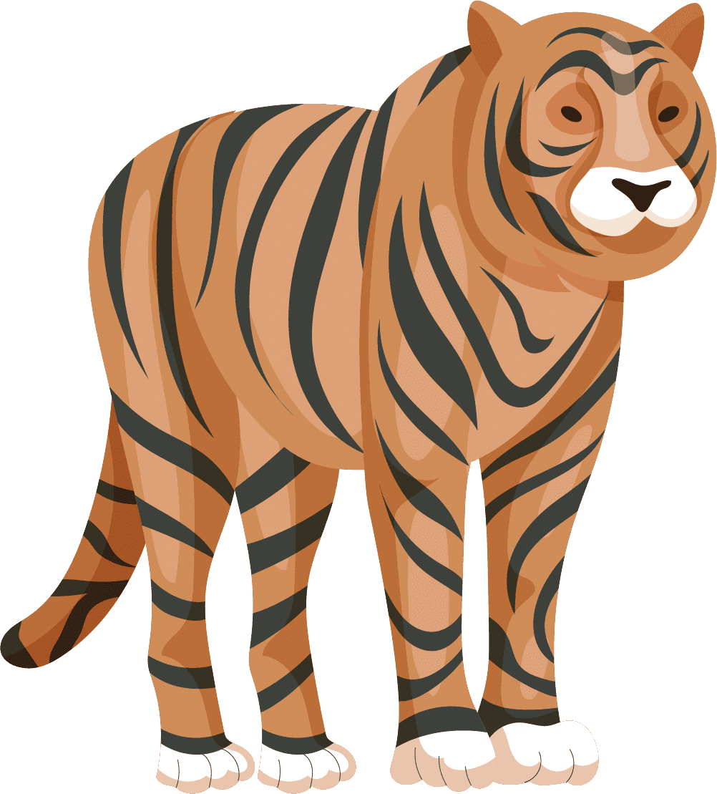
Architecture Diagram

Slide 14



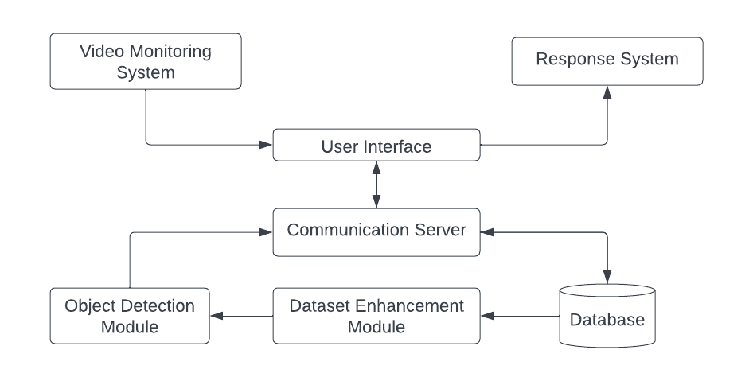

Architecture Diagram
Fig 1. Architecture Diagram of Crop Guard System

Slide 15





Data Flow Diagram

Slide 16

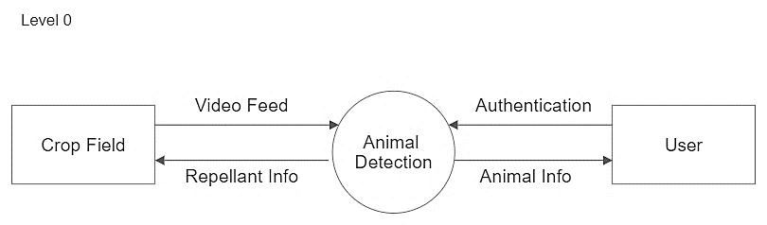


Data Flow Diagram
Fig 2. Level 0 of Data Flow Diagram

Slide 17
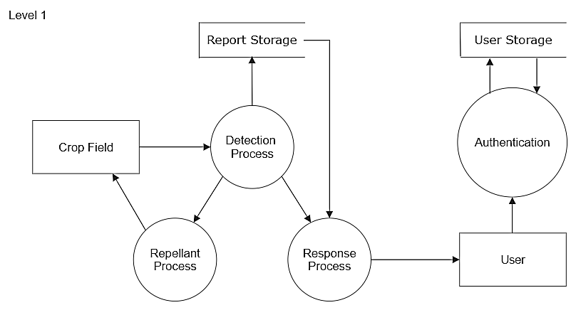
Data Flow Diagram
Fig 3. Level 1 of Data Flow Diagram

Slide 18
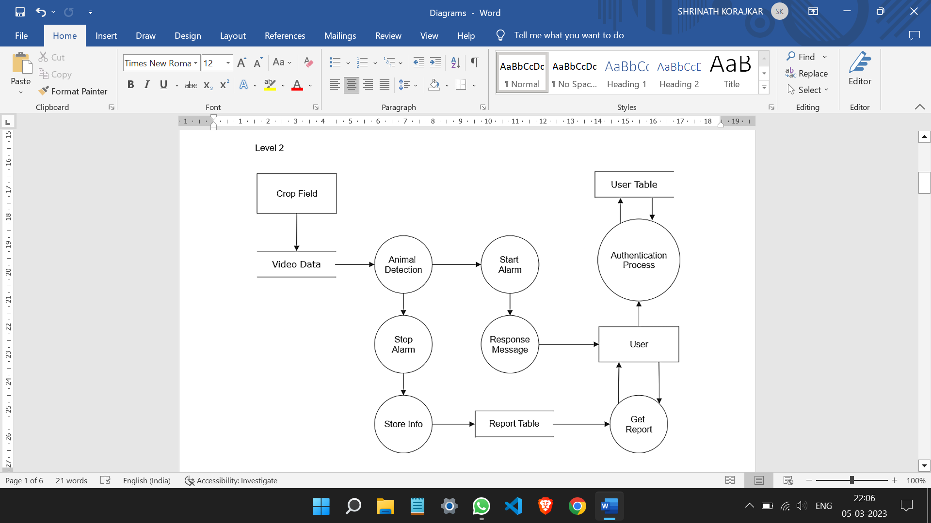


Data Flow Diagram
Fig 4. Level 2 of Data Flow Diagram

Slide 19




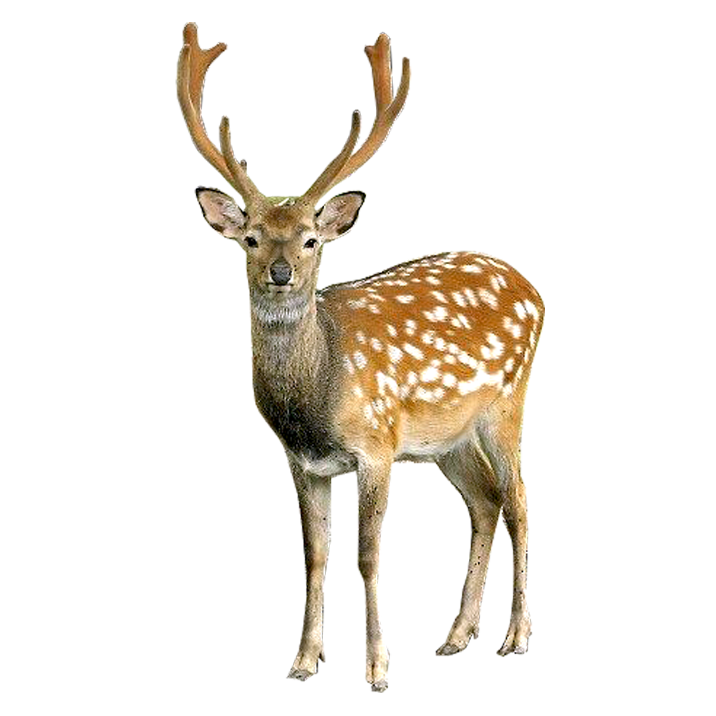

Use Case Diagram

Slide 20
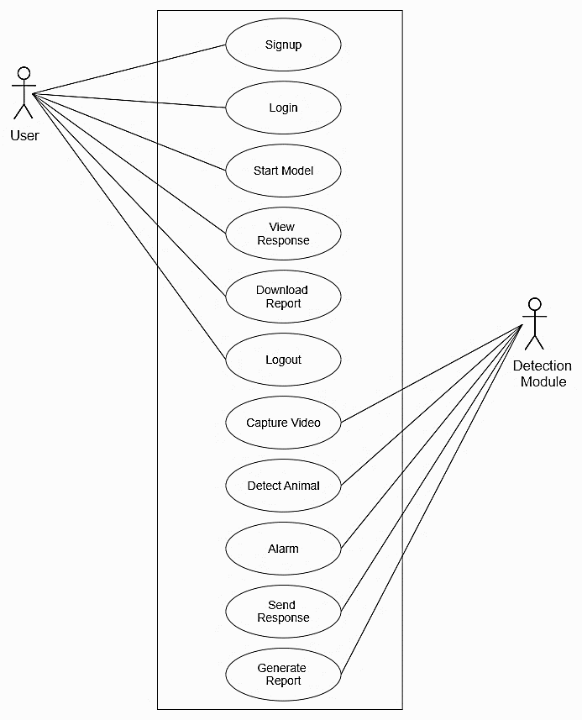
Use Case Diagram
Fig 5. Use Case Diagram of Crop Guard System

Slide 21


Sequence Diagram

Slide 22



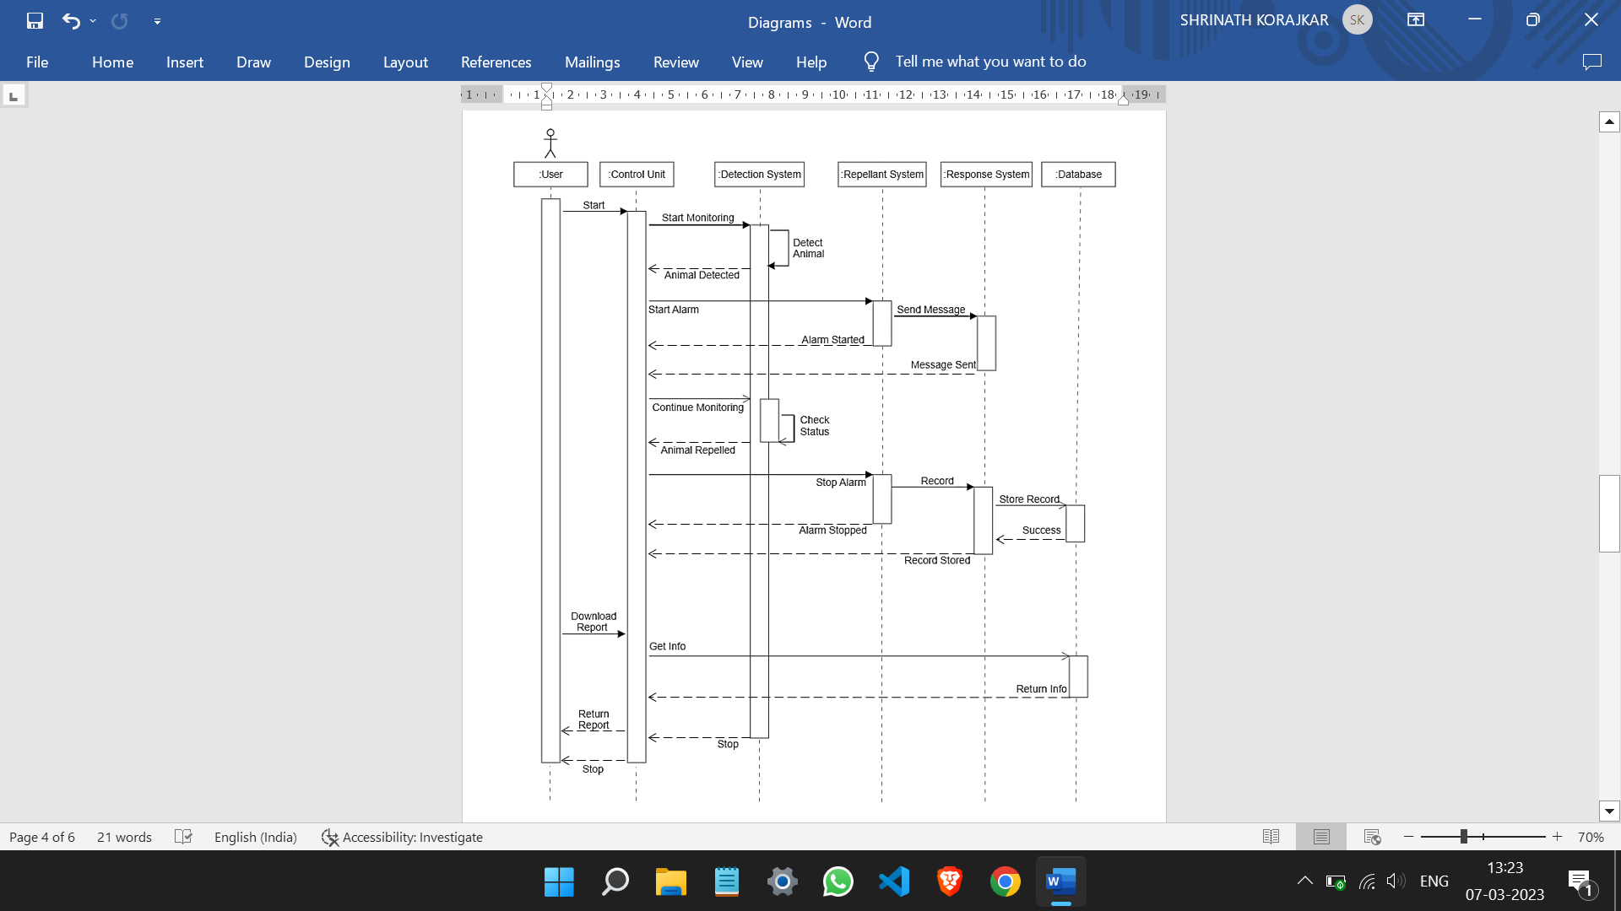


Sequence Diagram
Fig 6. Sequence Diagram of Crop Guard System

Slide 23


Activity Diagram

Slide 24



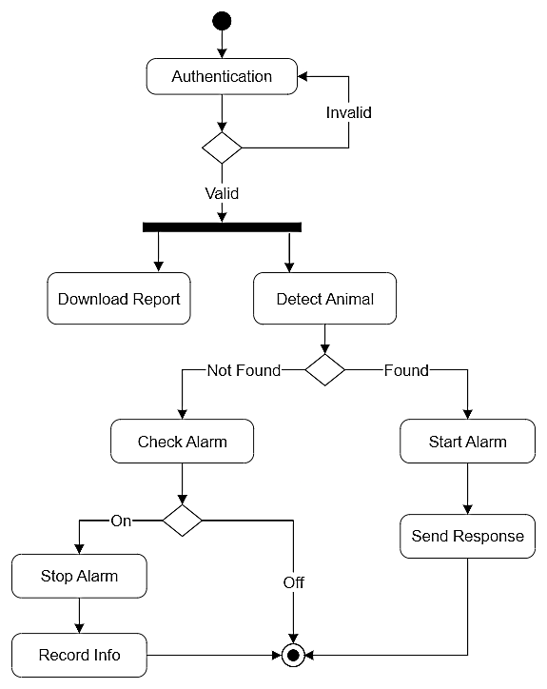



Activity Diagram
Fig 7. Activity Diagram of Crop Guard System

Slide 25



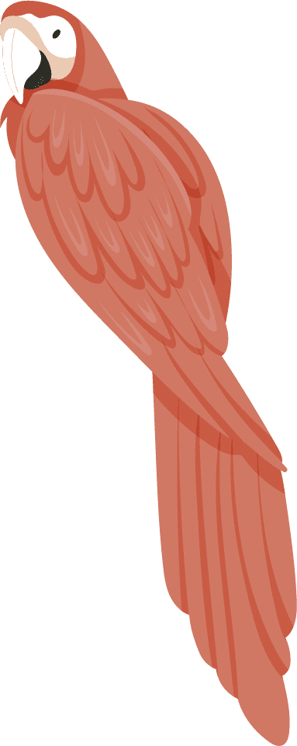

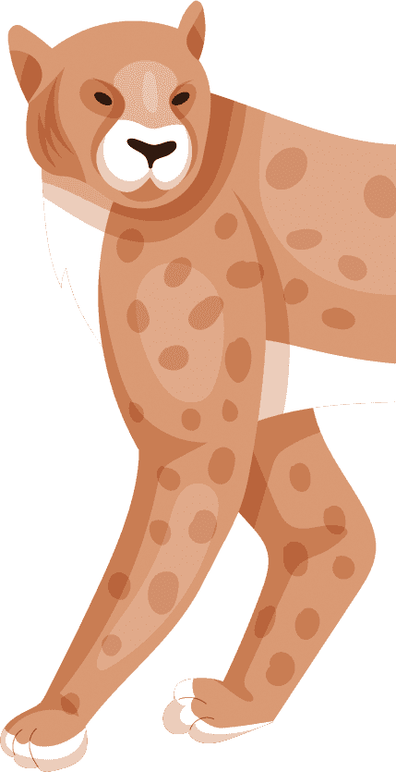
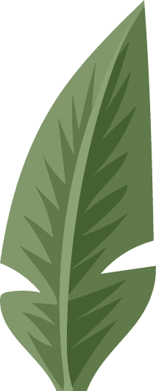
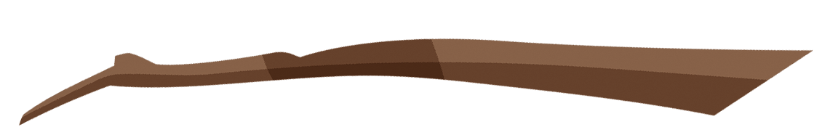
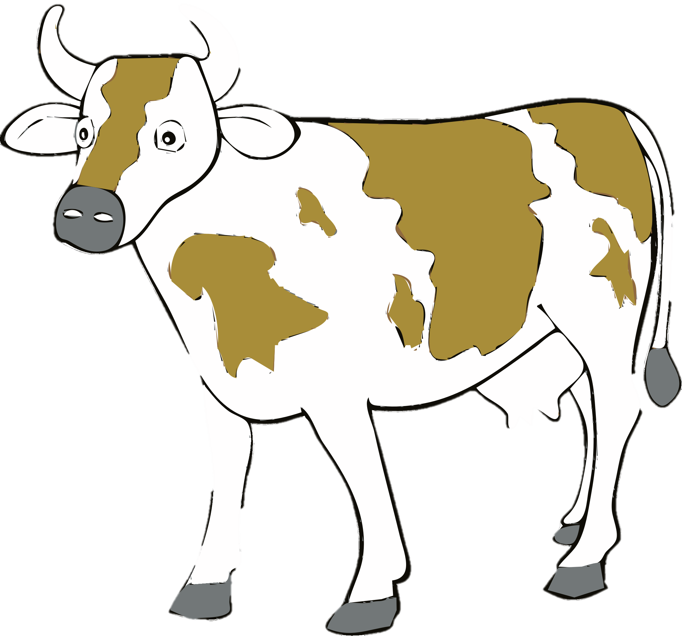



Process Flow Diagram

Slide 26

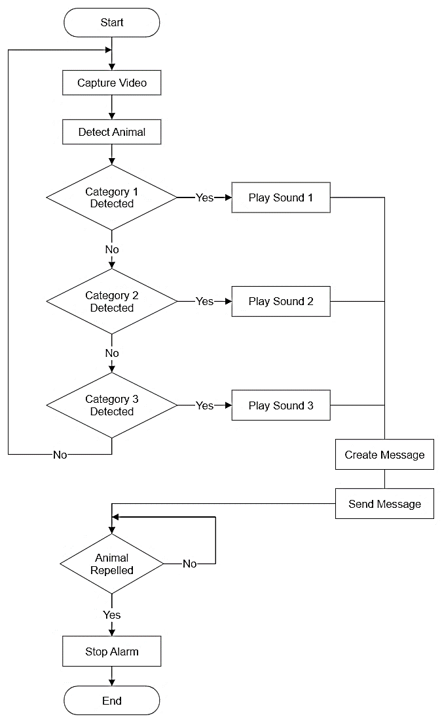
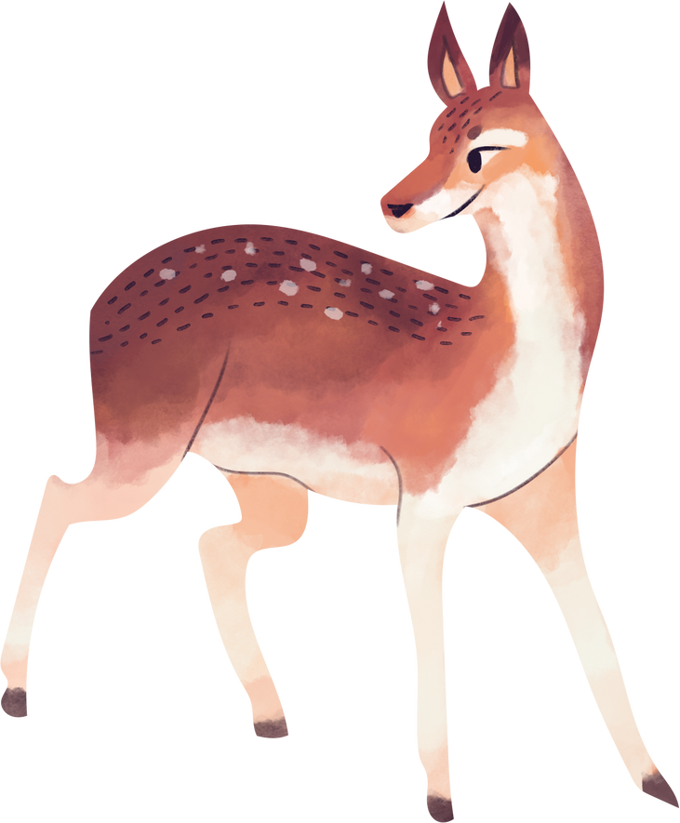

Process Flow Diagram
Fig 8. Process Flow Diagram of Crop Guard System

Slide 27

Snapshots

Slide 28

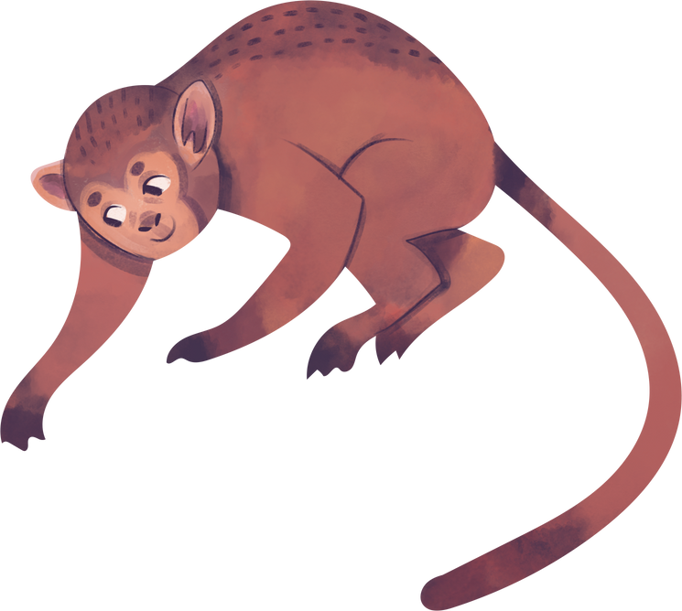


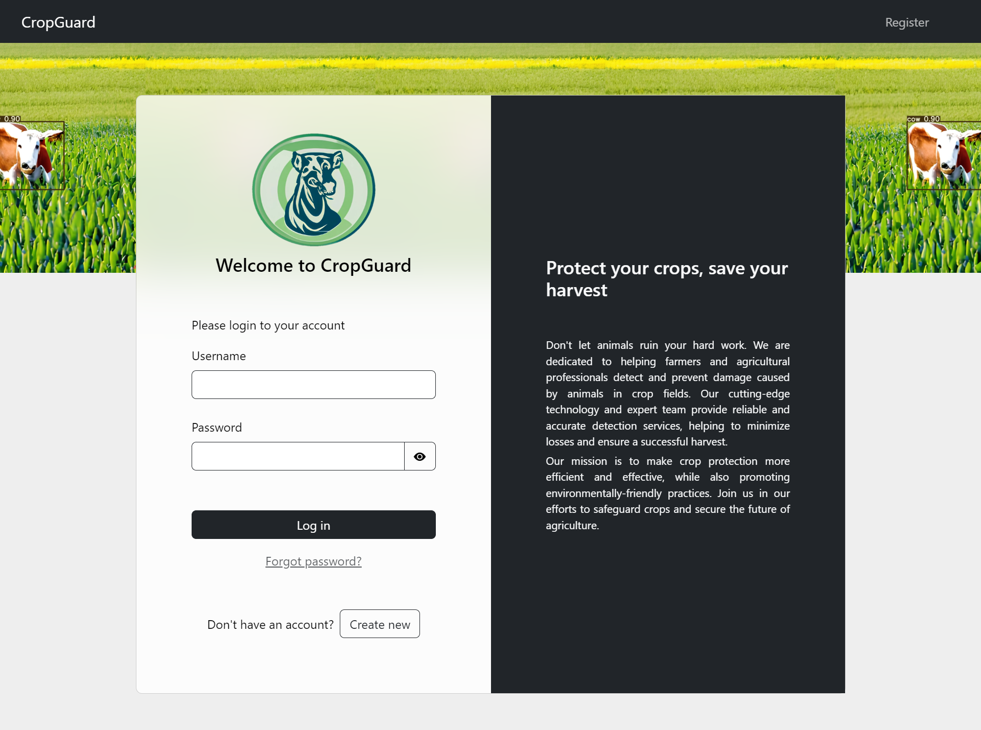
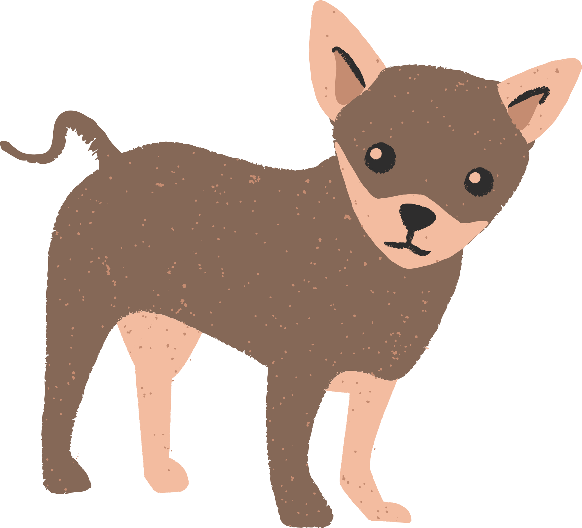
Snapshots
Fig 9. Index Page of Crop Guard Website

Slide 29
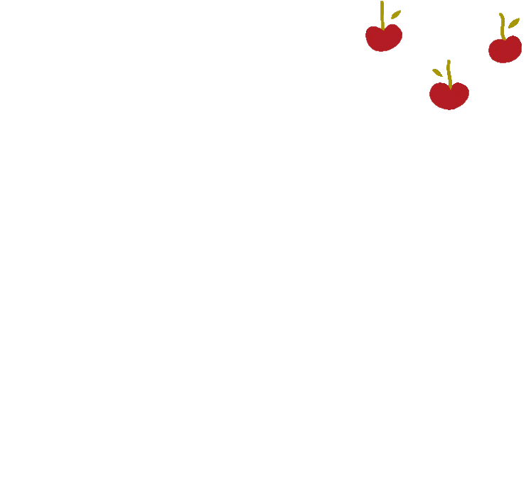
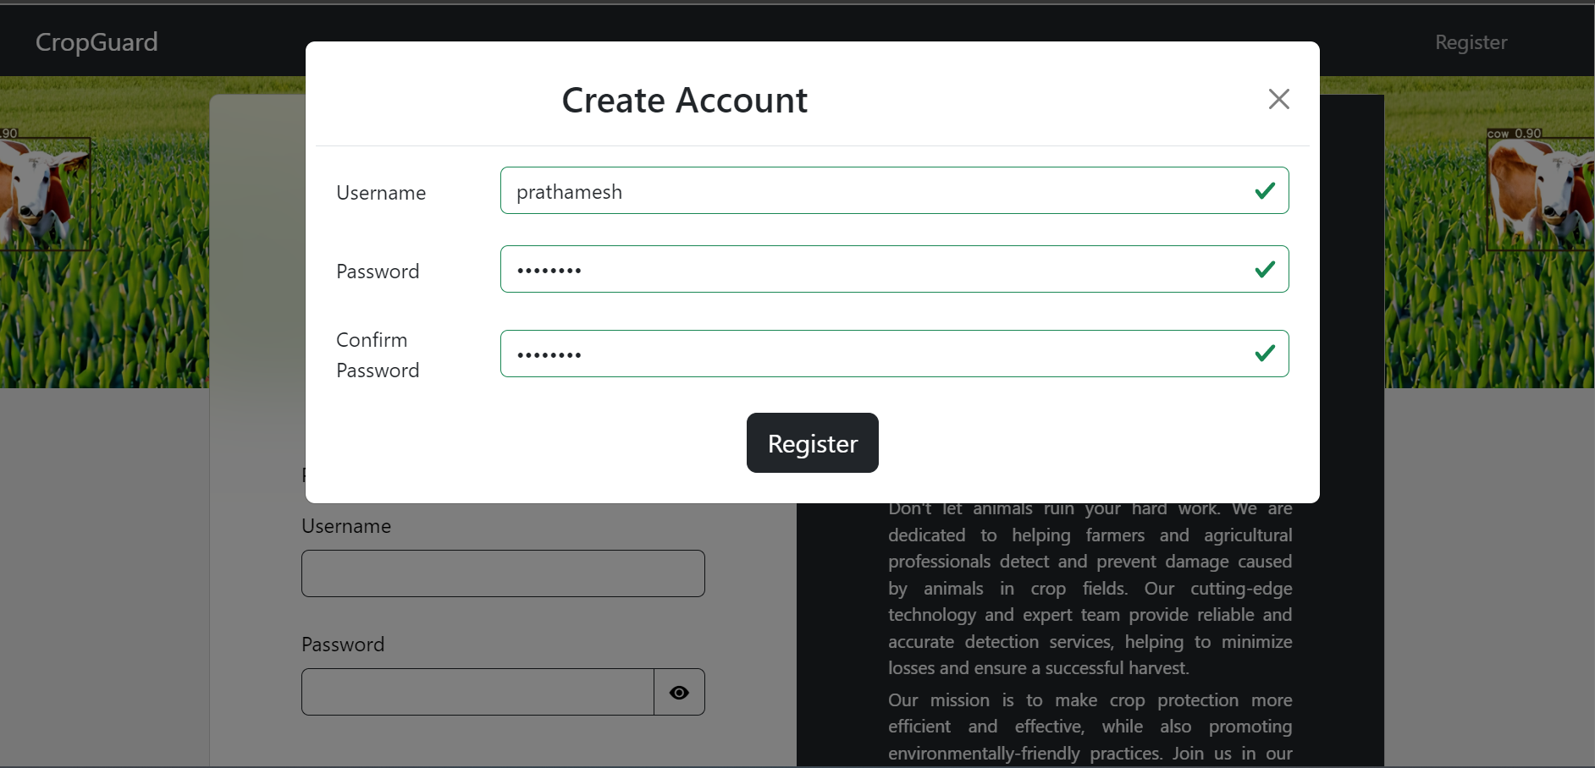

Snapshots
Fig 10. Register Page of Crop Guard Website

Slide 30
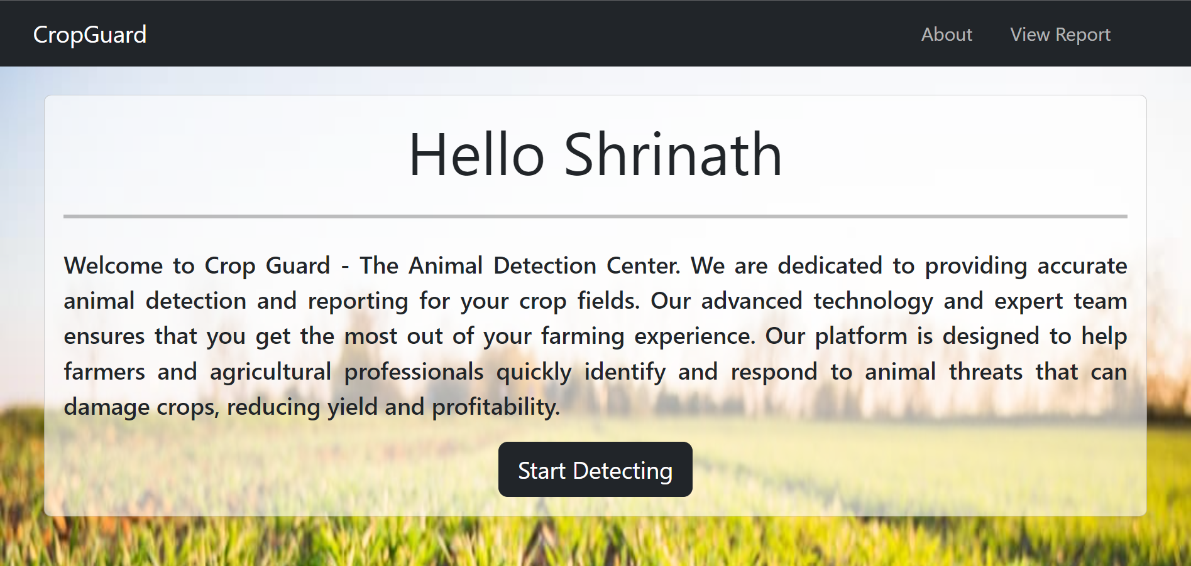
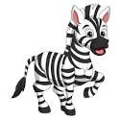
Snapshots
Fig 11. Home Page of Crop Guard Website

Slide 31
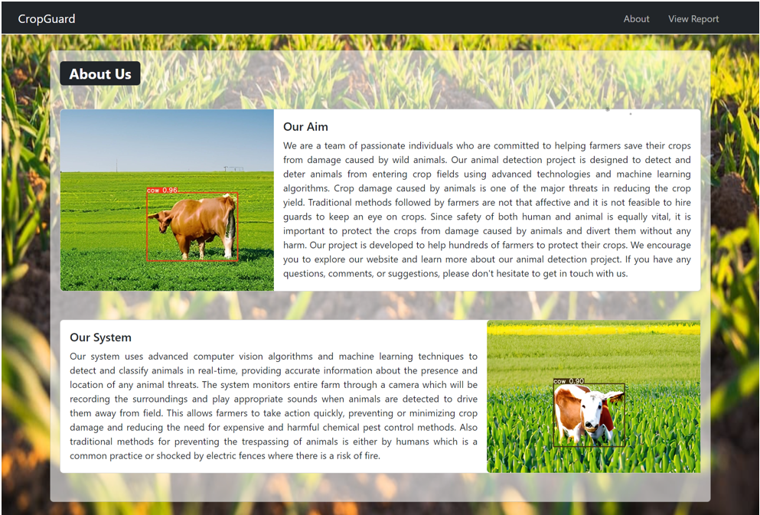

Snapshots
Fig 12. About Page of Crop Guard Website

Slide 32
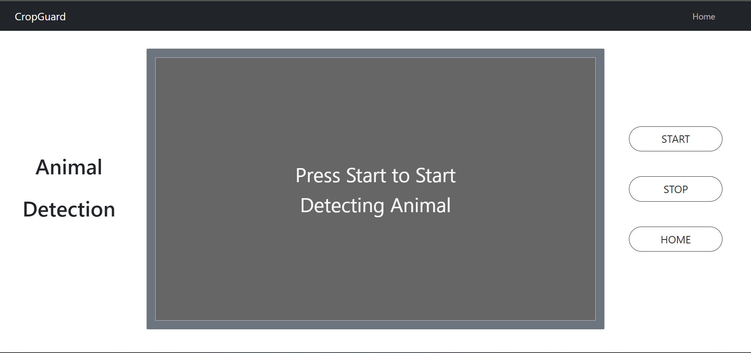

Snapshots
Fig 13. Detection Page of Crop Guard Website

Slide 33
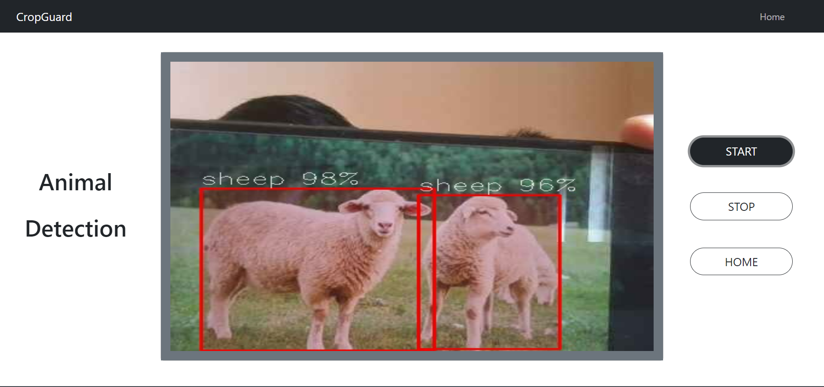
Snapshots
Fig 14. Live Animal Detection

Slide 34
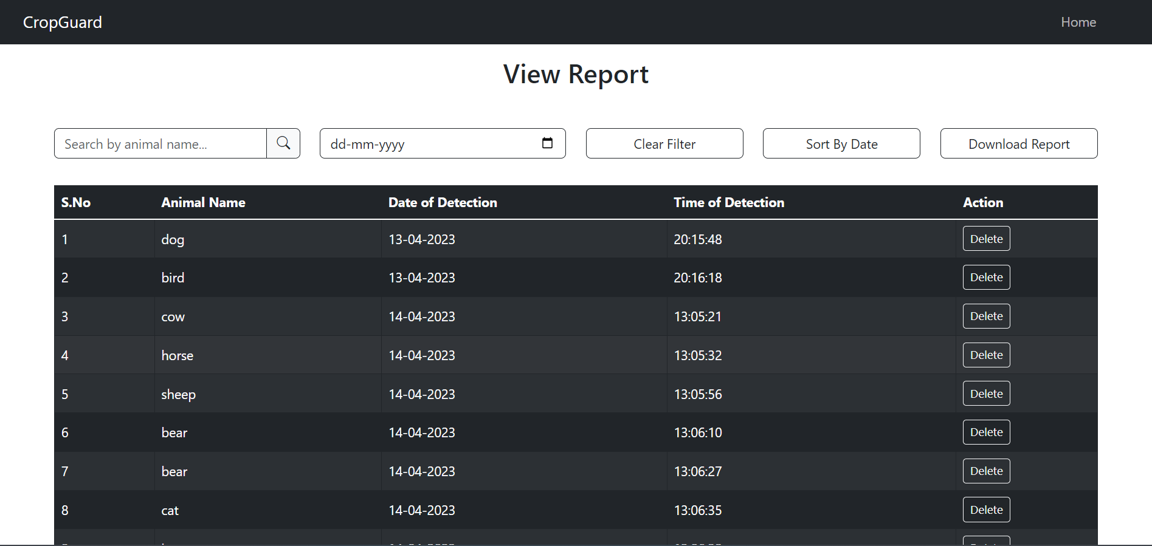
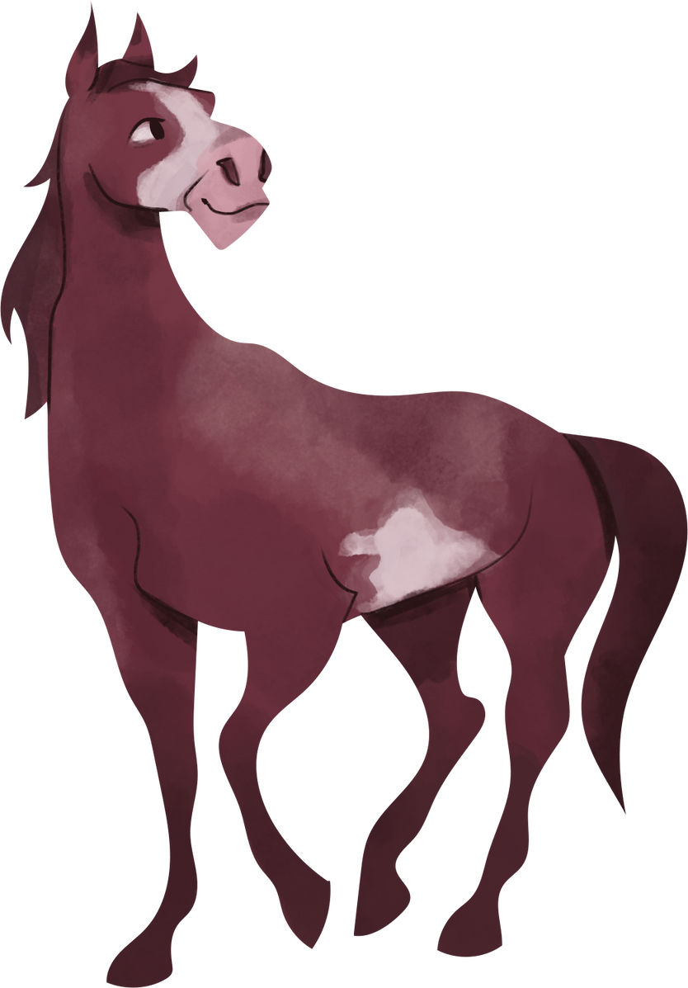
Snapshots
Fig 15. Report Page of Crop Guard Website

Slide 35
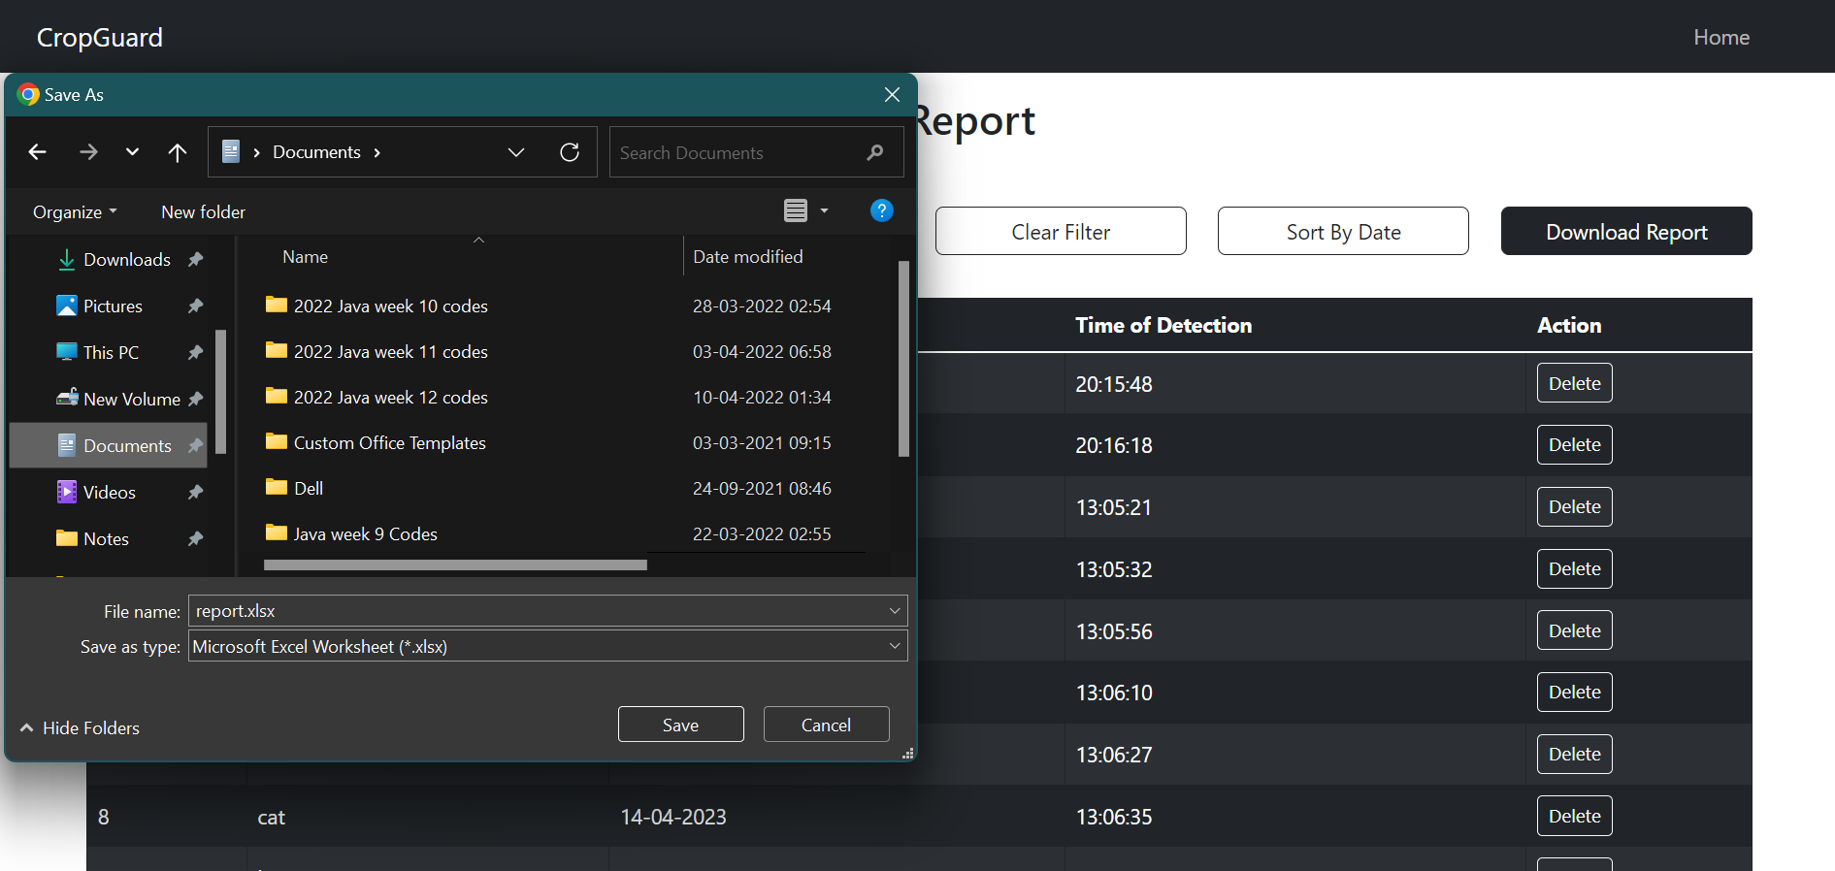
Snapshots
Fig 16. Download Report

Slide 36
Comparison Table
PAPER TITLE | APPROACH | ACCURACY
Adami, D., Ojo, M. O., & Giordano, S. (2021). Design, Development and Evaluation of an Intelligent Animal Repelling System for Crop Protection Based on Embedded Edge-AI. IEEE Access, 9, 132125-132139. | YOLO v3, PIR sensor | 82.50 %
Balakrishna, K., Mohammed, F., Ullas, C. R., Hema, C. M., & Sonakshi, S. K. (2021). Application of IOT and machine learning in crop protection against animal intrusion. Global Transitions Proceedings, 2(2), 169-174. | SDD | 89.32 %
Schindler, F., & Steinhage, V. (2021). Identification of animals and recognition of their actions in wildlife videos using deep learning techniques. Ecological Informatics, 61, 101215. | Mask R-CNN, Infrared Camera, | 63.80 %
Banupriya, N., Saranya, S., Swaminathan, R., Harikumar, S., & Palanisamy, S. (2020). Animal detection using deep learning algorithm. J. Crit. Rev, 7(1), 434-439. | CNN | 86.79 %
Kekre, O., Paliwal, A., Mehatkar, S., & Hazare, R. (2019). Ethical Crop Protection. | KNN, PIR sensor | 82.70 %
Proposed Model | YOLO v7, LSGAN | 96.00 %
Table 1. Performance Comparison

Slide 37
Conclusion
The "Animal Detection in Crop Fields" project aimed to develop a user-friendly, fast, and cost-effective software that detects wild animals entering farms or crop fields and drives them away using an alarm system. We were able to successfully train the model to achieve an accuracy of 96%. The proposed system will monitor the entire farm through a camera that records the surroundings and plays appropriate sounds when animals are detected to drive them away from the field. The system is economical, time-saving, and supports farmers in protecting their crops from damage caused by animals while ensuring the safety of both human and animal.

Slide 38
REFERENCES
Christine Dewi, Rung-Ching Chen, Yan-Ting Liu, Xiaoyi Jiang, Kristoko Dwi Hartomo , “Yolo v4 for Advanced Traffic Sign Recognition With Synthetic Training Data Generated by various GAN”. https://ieeexplore.ieee.org/document/9471877
DR. R.S. Sabeenian, N. Deivanai, B. Mythili, “Wild Animal Intrusion Detection using Deep Learning Techniques”.
https://www.researchgate.net/publication/344387269
Devsmit Ranparia, Gunjeet Singh, Anmol Rattan, Dr. Harpreet Singh, Dr. Nitin Auluck , “Machine Learning-based Acoustic Repellent System for Protecting Crops Against Wild Animal Attacks”. https://ieeexplore.ieee.org/abstract/document/9342713
Yu Ma, Yan Liang, Wan Ying Zhang, Shi Yan , “SAR Target Recognition Based on Transfer Learning and Data Augmentation with LSGANs”.
https://ieeexplore.ieee.org/document/8996717

Slide 39
REFERENCES
Adami, D., Ojo, M. O., & Giordano, S. (2021). Design, Development and Evaluation of an Intelligent Animal Repelling System for Crop Protection Based on Embedded Edge-AI. IEEE Access, 9, 132125-132139.
Balakrishna, K., Mohammed, F., Ullas, C. R., Hema, C. M., & Sonakshi, S. K. (2021). Application of IOT and machine learning in crop protection against animal intrusion. Global Transitions Proceedings, 2(2), 169-174.
Schindler, F., & Steinhage, V. (2021). Identification of animals and recognition of their actions in wildlife videos using deep learning techniques. Ecological Informatics, 61, 101215.
Banupriya, N., Saranya, S., Swaminathan, R., Harikumar, S., & Palanisamy, S. (2020). Animal detection using deep learning algorithm. J. Crit. Rev, 7(1), 434-439.
Kekre, O., Paliwal, A., Mehatkar, S., & Hazare, R. (2019). Ethical Crop Protection.

Slide 40

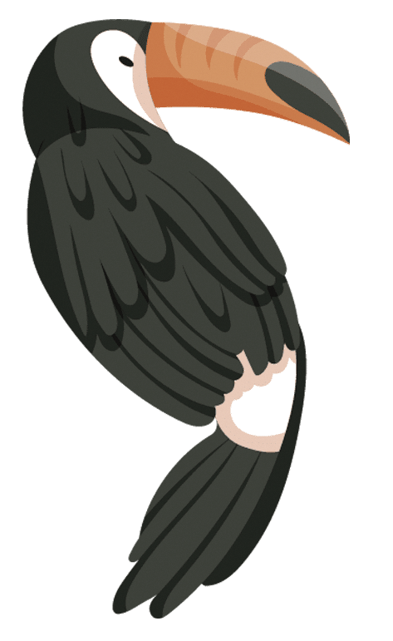
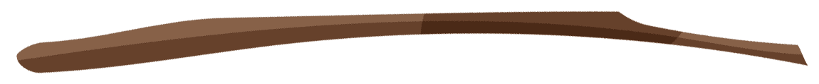

THANK YOU

